Slide 1



LeetCode 101
The Underlying Fourteen Patterns
ACM @ UCR Winter Workshop 1

Slide 2




Context
What is LeetCode?
Started as a repository of common technical interview questions
Expanded to a bank of coding challenges that companies often pull questions from
Why should we be studying this stuff?
Do you want to be a productive member of society or do you want to be an underwater basket weaver
Technical interview questions
Big money

Slide 3
The 14 Patterns
Sliding Window
Two Pointers or Iterators
Fast and Slow Pointers
Merge Intervals
Cyclic Sort
In-Place Reversal of Linked List
Tree BFS
Tree DFS
Two Heaps
Subsets
Modified Binary Search
Top K Elements
K-Way Merge
Topological Sort
Leetcode problems can be boiled down to basic patterns
Brute force into optimization
Recognizing the pattern can often lead you to towards a O(n) solution
Knowing is half the battle

Slide 4

Initial Setup
Make a LeetCode account
Done
Optional Steps:
Buy LeetCode premium
Laugh
Notes:
You get access to solutions for all applicable questions (e.g. some questions have a solution for free accounts but most don’t)
You get access to tagged questions e.g. there are lists of questions tagged to a company such as google
You get access to some leetcode premium only questions

Slide 5
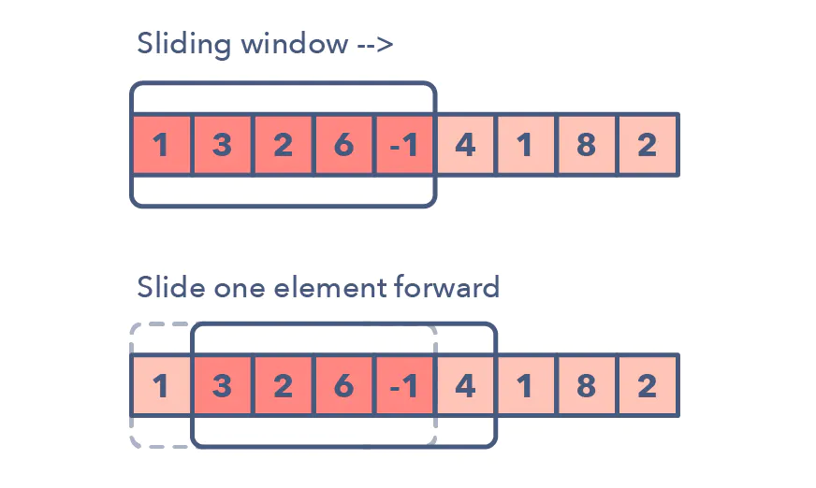
1. Sliding Window
Used when we want to operate on a specific window size of a linked list/array
Window slides from the start to the end of the array
Traverse one element at a time

Slide 6
1. Sliding Window
How to identify:
Linked list, array, string
Find a substring of a certain quality
Analyze a portion of a linear data structure of a certain size
Example problems:
Max sum subarray of size ‘K’
Longest substring with ‘K’ distinct characters
String anagrams

Slide 7
Sliding Window Example Problem
https://leetcode.com/problems/number-of-sub-arrays-of-size-k-and-average-greater-than-or-equal-to-threshold/
Given an array of integers arr and two integers k and threshold, return the number of sub-arrays of size k and average greater than or equal to threshold.

Slide 8
Sliding Window Pseudocode
Find the sum of the first k ints
Add to counter if the average of sum over k is equal to or greater than the threshold
For the rest of the array
Slide window up by one element
Calculate the average of these k elements
If the k element’s average is greater than the threshold, add to the counter
Return counter

Slide 9
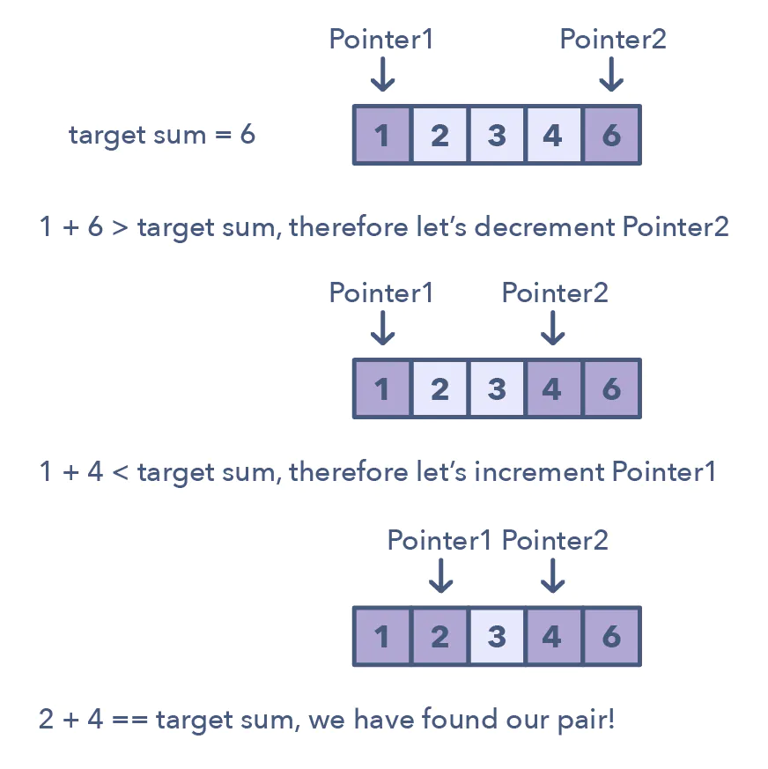
2. Two Pointers
Two pointers iterate through a data structure at the same time
Iterate until a certain condition is met
Alternative to looping through structure twice
Useful when searching pairs in a sorted array

Slide 10
2. Two Pointers
How to identify:
Sorted array / linked list
Need to find elements that fit a certain condition
Set that we need to find is a pair/triplet/subarray
Example problems:
Squaring a sorted array
Triplets that sum to zero
Comparing strings that contain backspaces

Slide 11
Two Pointers Example Problem
https://leetcode.com/problems/container-with-most-water/
You are given an integer array height of length n. There are n vertical lines drawn such that the two endpoints of the ith line are (i, 0) and (i, height[i]).
Find two lines that together with the x-axis form a container, such that the container contains the most water.
Return the maximum amount of water a container can store.

Slide 12
Two Pointers Pseudocode
Start at the beginning and end of the array
While the two pointers don’t intersect
Find the minimum height
Find the width
Find the area
If the area is larger than the current max, update it
Increment or decrement the pointer that has the smaller height
Return max

Slide 13
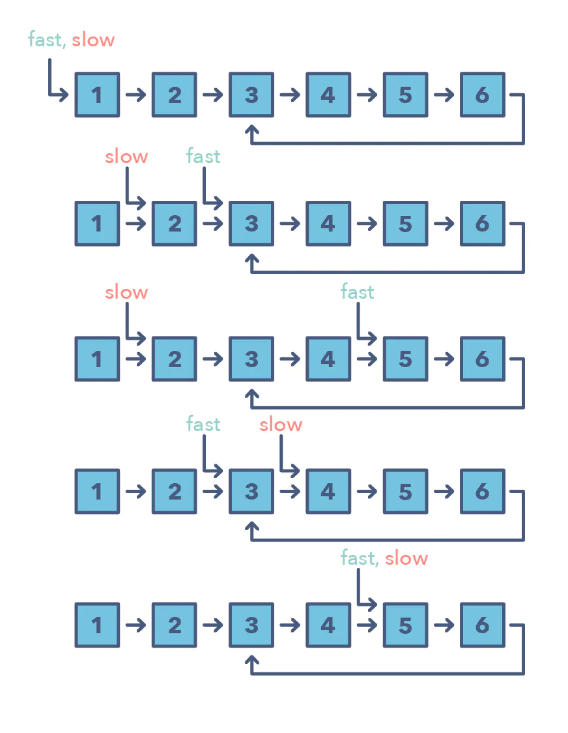
3. Fast and Slow Pointers
Also known as Floyd’s Cycle Detection Algorithm
Cyclic linked list/arrays
Two pointers that move at different speeds
They will catch up to each other due to their nature

Slide 14
3. Fast and Slow Pointers
How to identify:
Cycle in a linked list/array
Singly linked list
Can’t go backwards
Need to find position of an element or length of linked list
Example problems:
Linked list cycle
Palindrome linked list
Cycle in a circular array

Slide 15
Fast and Slow Pointers Example Problem
https://leetcode.com/problems/find-the-duplicate-number/
Given an array of integers nums containing n + 1 integers where each integer is in the range [1, n] inclusive.
There is only one repeated number in nums, return this repeated number.
You must solve the problem without modifying the array nums and uses only constant extra space.

Slide 16
Fast and Slow Pointers Pseudocode
Initialize two pointers (slow and fast)
While the loop isn’t found
Advance the slow pointer by one
Advance the fast pointer by two
Bring one pointer to the beginning
Advance both pointers at the same speed
Return the duplicate number

Slide 17
Resources
https://hackernoon.com/14-patterns-to-ace-any-coding-interview-question-c5bb3357f6ed
https://seanprashad.com/leetcode-patterns/
Github repo: https://github.com/seanprashad/leetcode-patterns#leetcode-study-guide
https://www.crackingthecodinginterview.com/contents.html
https://www.crackingthecodinginterview.com/uploads/6/5/2/8/6528028/cracking_the_coding_skills_-_v6.pdf

Slide 18
Thanks for coming!

